Slide 1

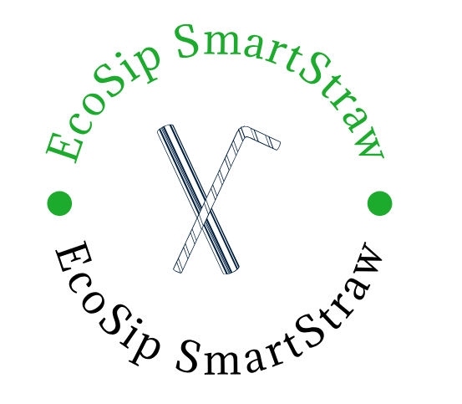

Business Foundations Capstone Framework for Analysis
Shaghayegh Haghbin
04/07/2024

Slide 2
Situational Analysis

Slide 3




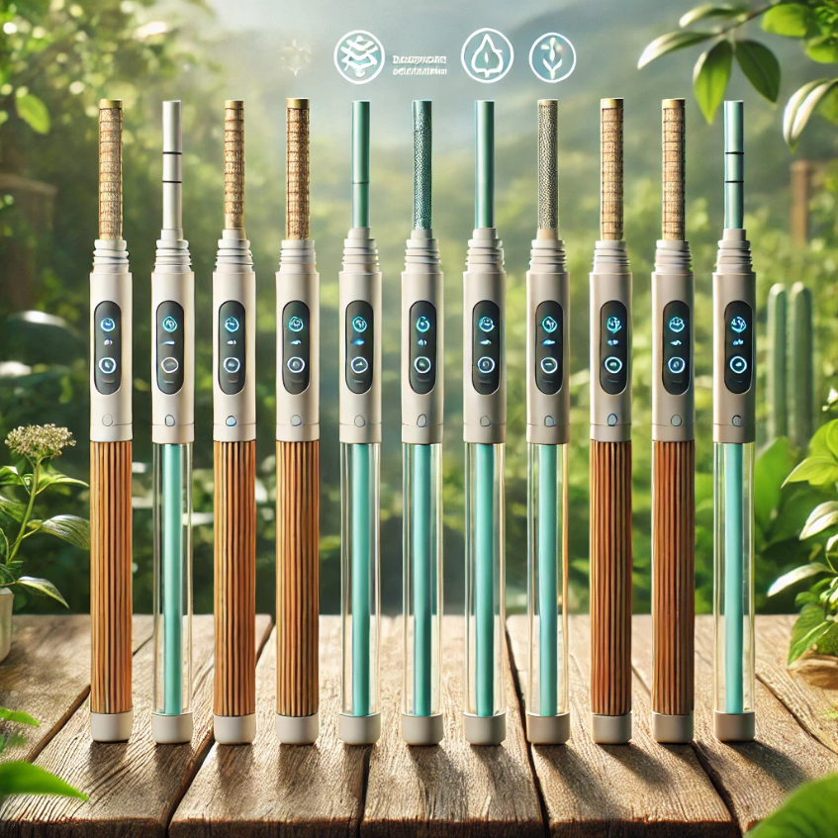
Product or Service– Describe the product or service you are developing a strategy for
The EcoSip SmartStraws are easily transported, biodegradable straws armed with advanced filtration technology. This product permits users to drink directly from any water source, purifying the water on-the-go by excluding harmful bacteria, viruses, and contaminants.
Key Features:
Portable and Lightweight: Easy to carry in your backpack or pocket, making it ideal for travelers, campers, and outdoor enthusiasts.
User-Friendly Design: Simplicity in usage. The digital sensor alerts you to water quality, enhancing safety and convenience.
Potential Success Factors:
High Demand: A lifesaver for areas with limited access to clean water. Useful for travelers and outdoor enthusiasts who require a reliable water purification solution. A strong appeal to eco-conscious consumers looking to reduce their plastic footprint.
Development Suggestions:
Non - Governmental Partnerships: Collaborate with non-governmental organizations to distribute the straw in developing countries, aiding communities with limited access to clean water.
Enhanced Safety Features: Incorporate a small digital sensor that alerts users to the quality of water, providing an extra layer of safety.

Slide 4
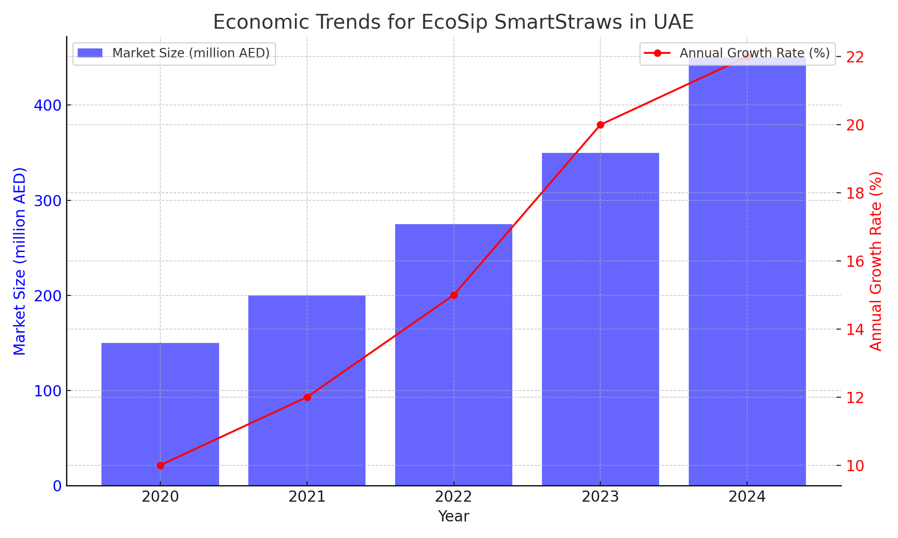
External Environment – Relevant economic, social, political, legal, technological trends
Economic Trends:
Sustainable Market Growth: The global market for eco-friendly and sustainable products is growing rapidly. Consumers are willing to pay a premium for products that align with their values, driving economic growth in this sector.
Increasing Disposable Income: As disposable incomes rise, especially in emerging markets, consumers have more spending power to invest in health and eco-conscious products like EcoSip SmartStraws.
The economic trend for EcoSip SmartStraws in the UAE shows significant growth from 2020 to 2024. The market size increased from 150 million AED in 2020 to 450 million AED in 2024, reflecting a strong and consistent expansion.
The annual growth rate also rose from 10% in 2020 to 22% in 2024, indicating accelerating market momentum and increasing consumer demand for eco-friendly products.
A robust and growing market is driven by rising disposable incomes and heightened consumer interest in sustainable products.

Slide 5
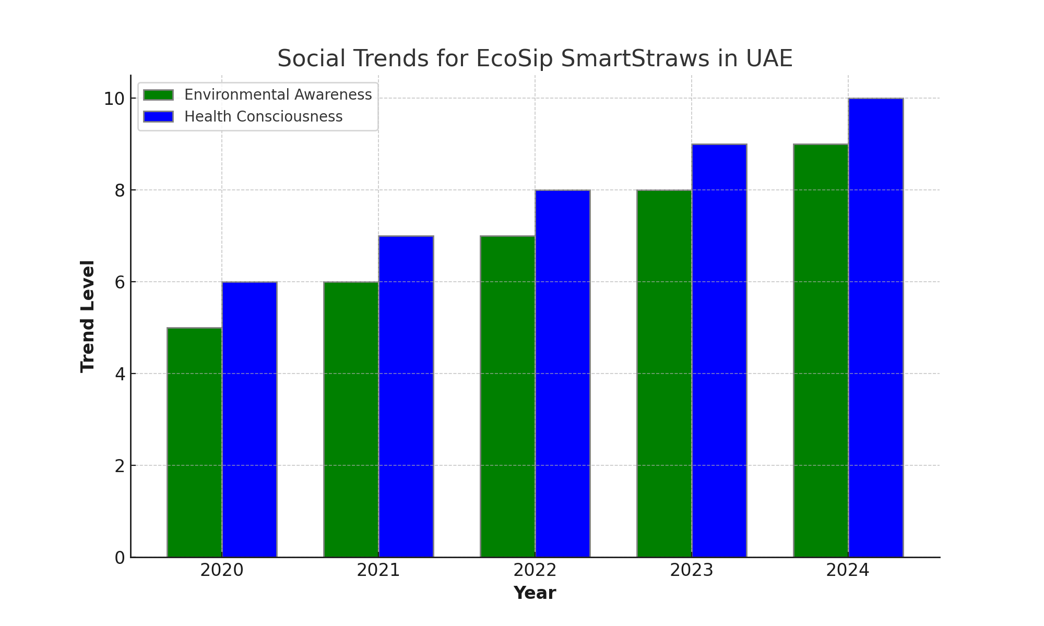
External Environment – Relevant economic, social, political, legal, technological trends
Social Trends:
Environmental Awareness: There is a significant increase in awareness and concern about environmental issues. Consumers are actively seeking out sustainable products to reduce their ecological footprint.
Health Consciousness: People are becoming more health-conscious, looking for products that ensure their safety and well-being. Clean drinking water is a major concern, making products like EcoSip SmartStraws highly desirable.
The social trend analysis for EcoSip SmartStraws in the UAE shows a steady increase in both environmental awareness and health consciousness from 2020 to 2024.
Environmental awareness rose from 5 to 9, while health consciousness increased from 6 to 10 on a scale of 1 to 10.
This indicates a growing consumer preference for sustainable and health-oriented products, suggesting a favorable market environment for EcoSip SmartStraws driven by heightened ecological and health concerns.

Slide 6
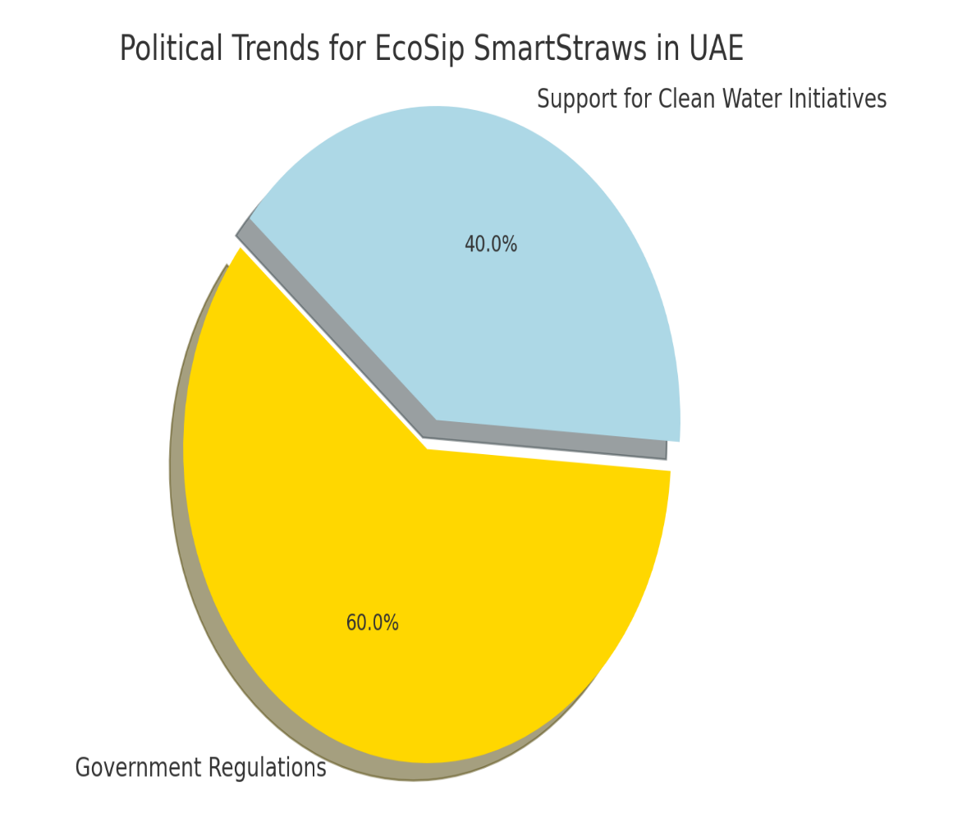
External Environment – Relevant economic, social, political, legal, technological trends
Political trends:
Government Regulations: Many governments are implementing stricter regulations on plastic use and promoting sustainability. This creates a favorable environment for biodegradable products.
Support for Clean Water Initiatives: Governments and international organizations are supporting initiatives that ensure access to clean drinking water, which aligns with the benefits provided by EcoSip SmartStraws.
The political trend analysis for EcoSip SmartStraws in the UAE highlights that government regulations (60%) and support for clean water initiatives (40%) are key drivers.
Stricter regulations on plastic use and sustainability promotion create a favorable market for biodegradable products.
The governmental and international support for clean drinking water aligns with the benefits of EcoSip SmartStraws, further boosting their market potential.

Slide 7
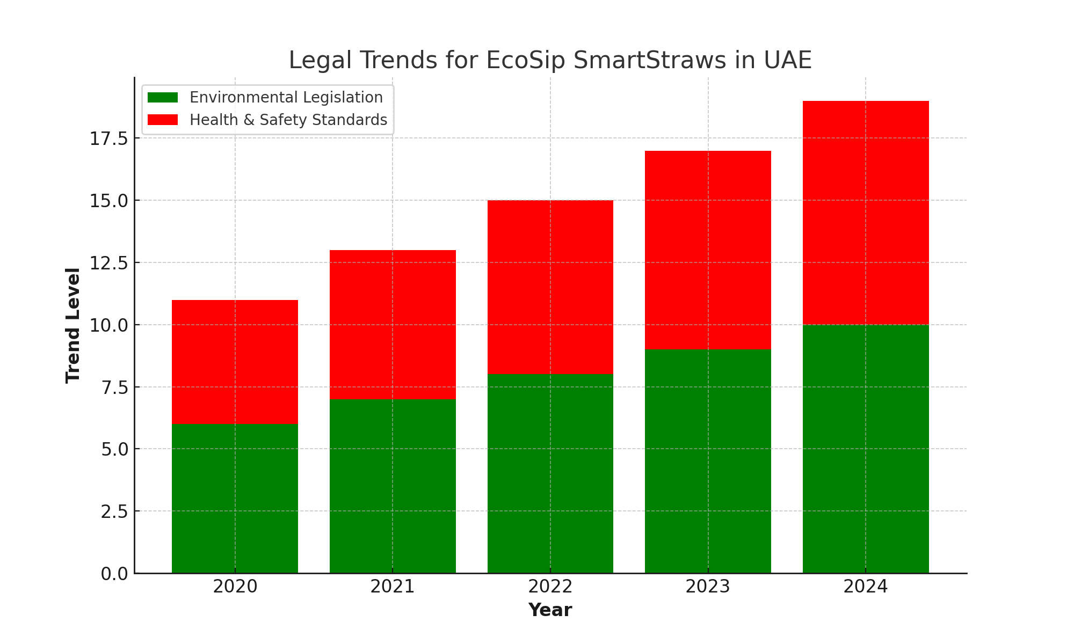
External Environment – Relevant economic, social, political, legal, technological trends
Legal trends:
Environmental Legislation: There is increasing legislation aimed at reducing plastic waste and encouraging the use of sustainable materials. Compliance with these laws is crucial for market entry and success.
Health and Safety Standards: Products that ensure health and safety, such as water purification devices, must meet rigorous standards. EcoSip SmartStraws must comply with these regulations to ensure market acceptance.
The legal trend analysis for EcoSip SmartStraws in the UAE shows a consistent increase in both environmental legislation and health and safety standards from 2020 to 2024.
Environmental legislation rose from 6 to 10, indicating stronger laws to reduce plastic waste and promote sustainable materials.
Health and safety standards also increased from 5 to 9, reflecting stricter regulations for product compliance.
This trend underscores the importance of adhering to these regulations for market success and acceptance.

Slide 8
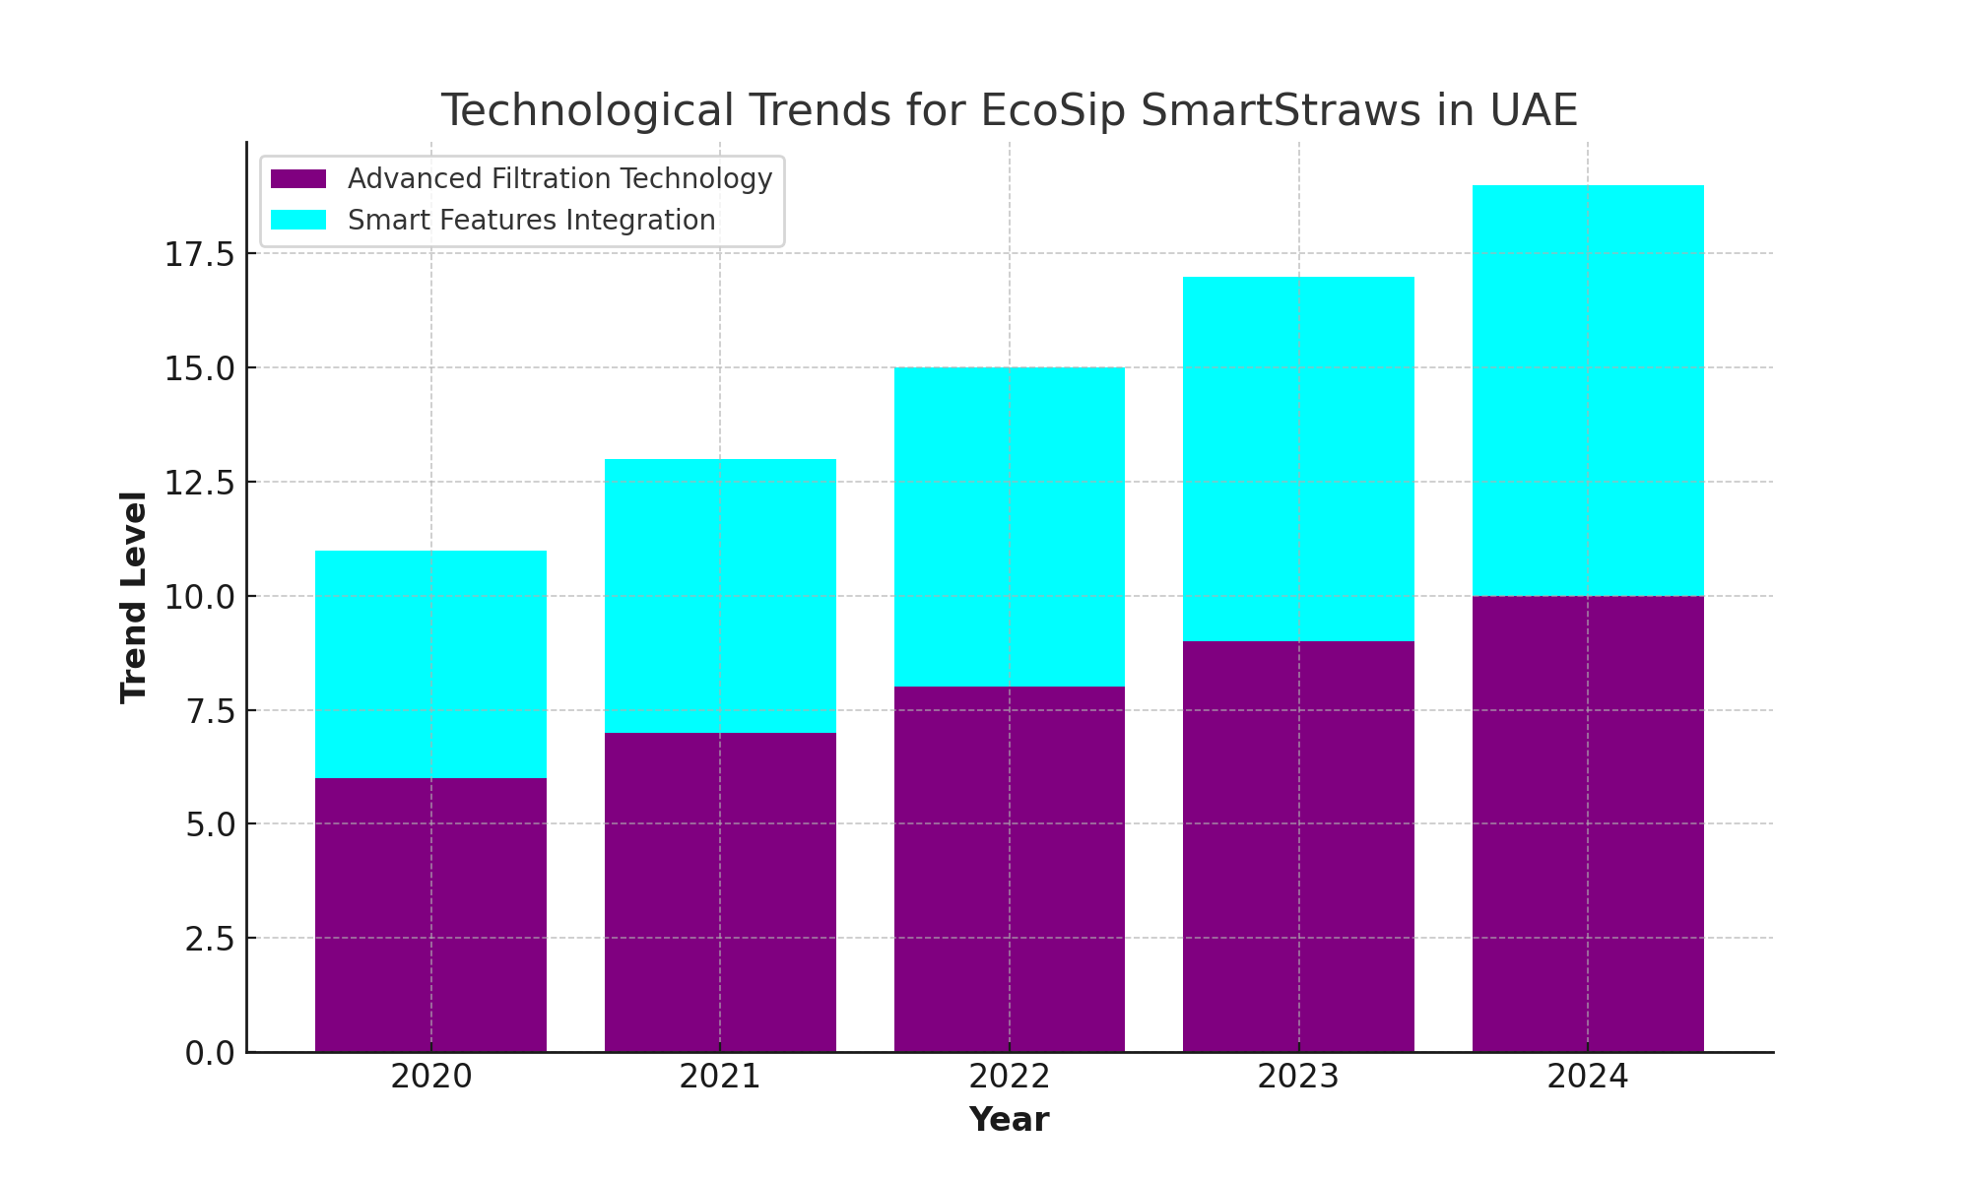
External Environment – Relevant economic, social, political, legal, technological trends
Technological trends:
Advanced Filtration Technology: Innovations in filtration technology are making portable water purification devices more effective and affordable. EcoSip SmartStraws leverage these advancements to provide safe drinking water.
Smart Features Integration: The integration of smart features, such as digital sensors for water quality detection, is becoming more common, adding value to products and enhancing user experience.
The technological trend analysis for EcoSip SmartStraws in the UAE shows a significant and consistent increase from 2020 to 2024.
Advanced filtration technology rose from 6 to 10, indicating rapid advancements in making portable water purification more effective and affordable.
Smart features integration increased from 5 to 9, reflecting the growing trend of incorporating digital sensors for water quality detection.
This trend highlights the importance of leveraging technological innovations to enhance product value and user experience.

Slide 9
External Environment – Nature and extent of demand (demand elasticity & size of the market)
Market Size and Growth:
The market for eco-friendly and sustainable products in the UAE is experiencing significant growth.
In 2020, the market size was estimated at 150 million AED, and it has steadily increased to an estimated 450 million AED by 2024.
This reflects a compound annual growth rate of approximately 18%, driven by increasing consumer awareness and preference for sustainable products.
Demand Elasticity:
The demand for eco-friendly products like EcoSip SmartStraws is relatively elastic.
Consumers are becoming more willing to switch to sustainable alternatives, especially when these products are competitively priced and offer additional benefits, such as health and safety improvements.
The price sensitivity is balanced by the value placed on environmental impact and health benefits, making demand moderately elastic.

Slide 10
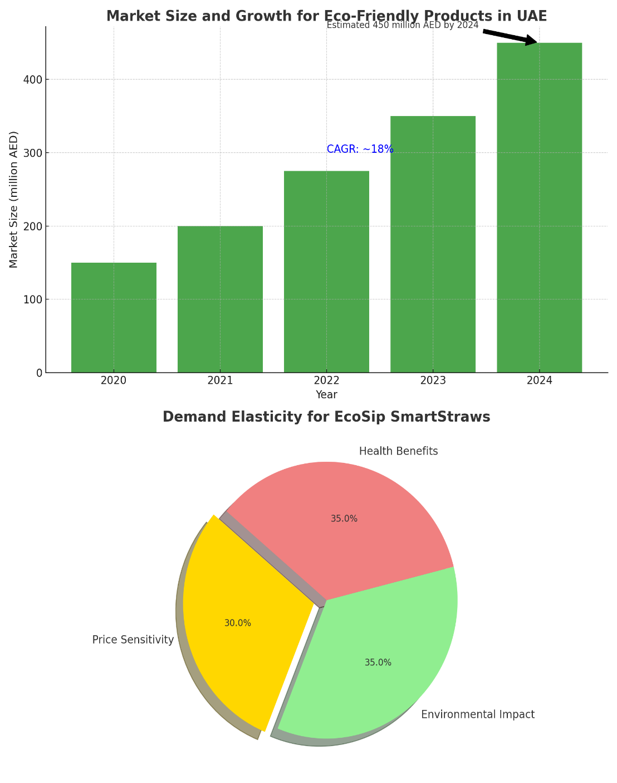

External Environment – Nature and extent of demand (demand elasticity & size of the market)
Market Size and Growth:
The market for eco-friendly products in the UAE shows significant growth from 2020 to 2024, with the market size increasing from 150 million AED to an estimated 450 million AED.
This reflects a compound annual growth rate of approximately 18%, driven by rising consumer awareness and preference for sustainable products.
Demand Elasticity:
The demand for EcoSip SmartStraws is moderately elastic, influenced by three key factors: price sensitivity (30%), environmental impact (35%), and health benefits (35%).
Consumers are increasingly willing to switch to sustainable alternatives, particularly when these products are competitively priced and offer significant health and environmental benefits.

Slide 11
External Environment – Nature and extent of demand (demand elasticity & size of the market)
Drivers of Demand:
Environmental Concerns: Growing awareness of environmental issues and the desire to reduce plastic waste are major drivers. Consumers are actively seeking products that contribute to sustainability.
Health and Safety: Increased focus on health and wellness is driving demand for products that ensure safe drinking water, particularly among travelers, outdoor enthusiasts, and in regions with limited access to clean water.
Government Regulations: Supportive policies and regulations promoting sustainability and reducing plastic usage are encouraging the adoption of biodegradable products.
Consumer Segments:
Eco-Conscious Consumers: Individuals who prioritize sustainability and are willing to pay a premium for eco-friendly products.
Travelers and Adventurers: Those who require reliable access to clean water during their travels and outdoor activities.
Health-Conscious Individuals: Consumers focused on health and safety, looking for products that protect them from contaminants.

Slide 12
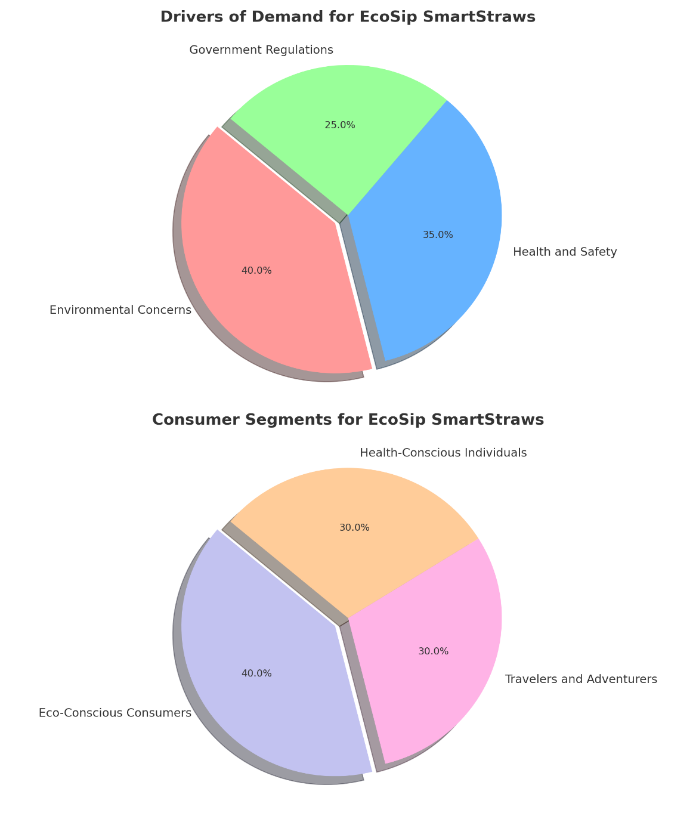
External Environment – Nature and extent of demand (demand elasticity & size of the market)
Drivers of Demand:
Environmental concerns (40%) are the primary driver for EcoSip SmartStraws, reflecting growing awareness of sustainability.
Health and safety (35%) follow closely, highlighting the importance of clean drinking water.
Government regulations (25%) also play a significant role, promoting the adoption of biodegradable products.
Consumer Segments:
Eco-conscious consumers (40%) are the largest segment, willing to pay a premium for sustainability.
Travelers and adventurers (30%) seek reliable access to clean water, while health-conscious individuals (30%) prioritize products that protect them from contaminants.

Slide 13
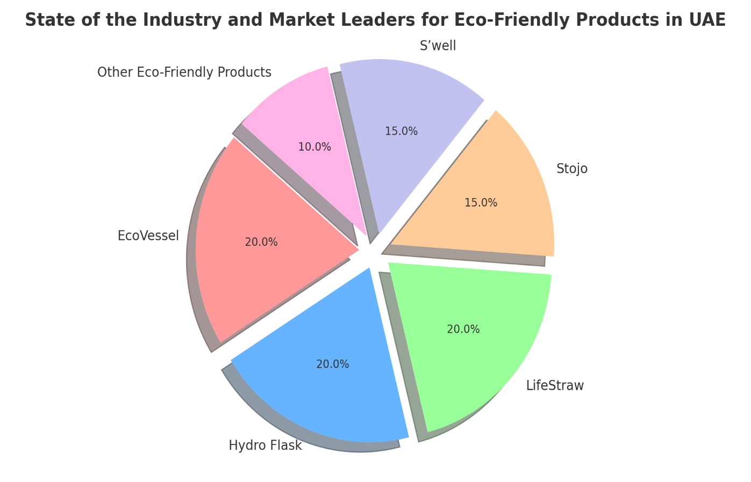
External Environment – Industry structure (entry/exit barriers)
State of the Industry:
The eco-friendly and sustainable products industry in the UAE is thriving, driven by increased consumer awareness and governmental support for sustainable practices.
This industry includes a wide range of products such as biodegradable utensils, reusable water bottles, eco-friendly packaging, and now, biodegradable water purification straws like EcoSip SmartStraws.
Current Leaders and Competitors:
Leaders: The industry is led by well-established brands like EcoVessel, Hydro Flask, and LifeStraw, which are known for their high-quality, eco-friendly products.
Competitors: Emerging brands such as Stojo and S’well are also gaining market share by offering innovative and sustainable solutions.

Slide 14
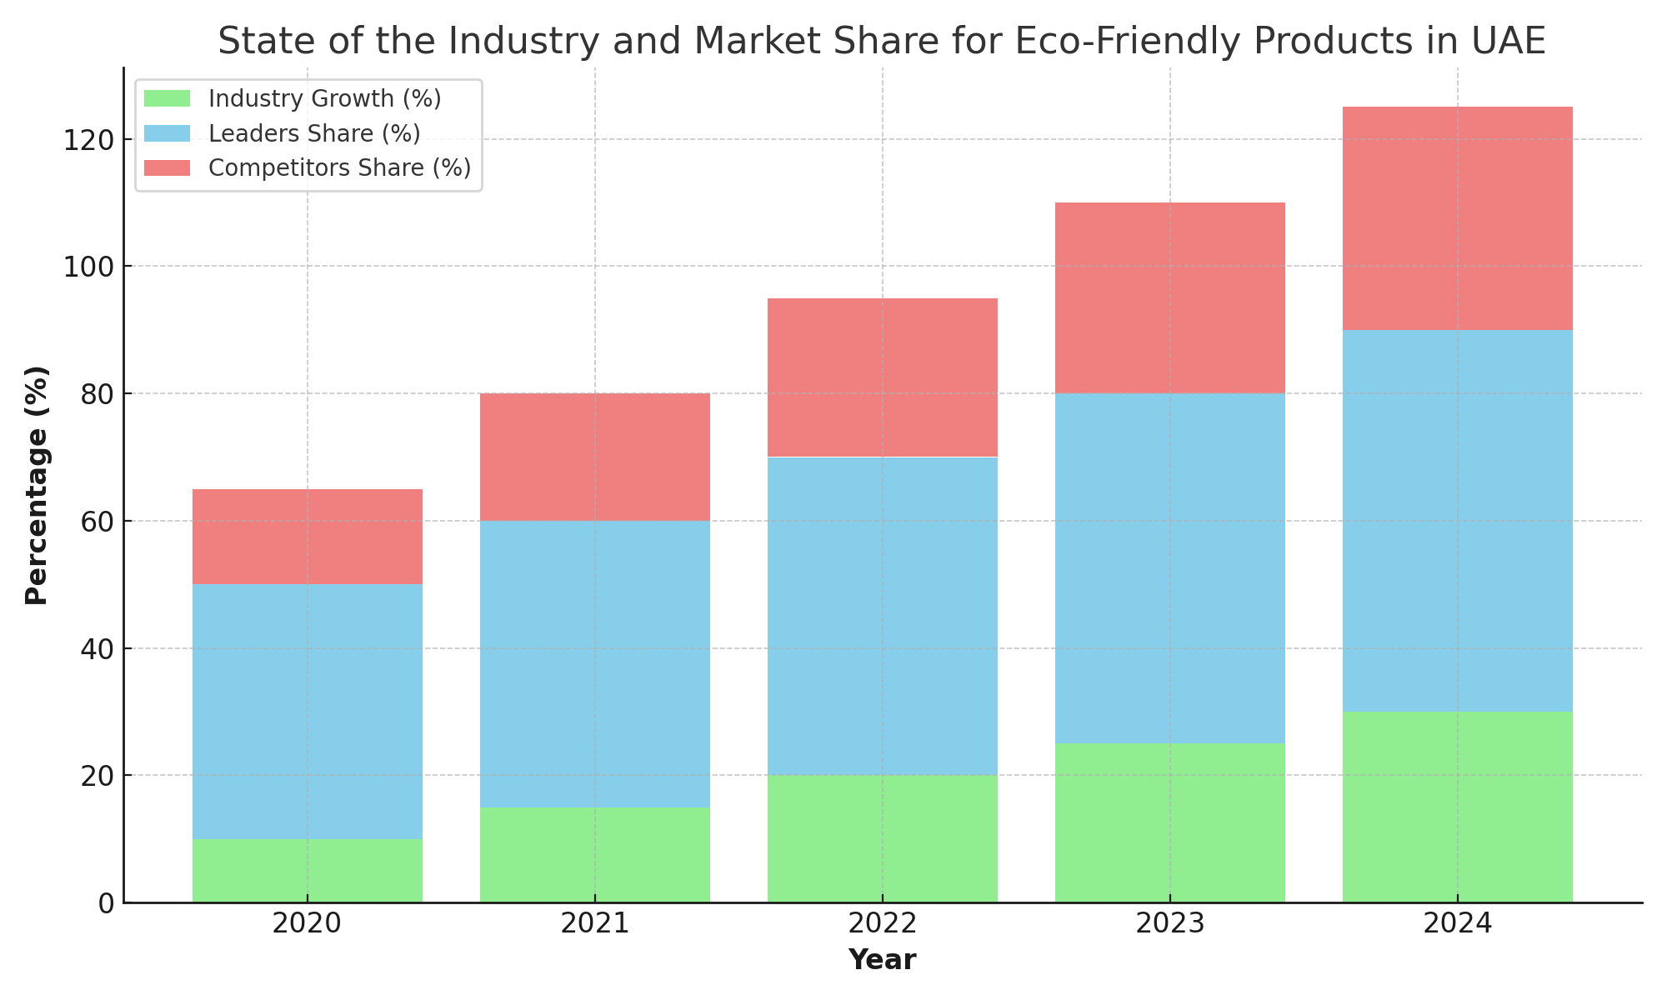
External Environment – Industry structure (entry/exit barriers)
State of the Industry:
The eco-friendly and sustainable products industry in the UAE is experiencing robust growth, with industry growth percentages increasing from 10% in 2020 to 30% in 2024.
This indicates a thriving market driven by heightened consumer awareness and strong governmental support for sustainable practices.
Current Leaders and Competitors:
Leaders: Established brands like EcoVessel, Hydro Flask, and LifeStraw dominate the market, with their market share rising from 40% in 2020 to 60% in 2024. These brands are recognized for their high-quality and eco-friendly products.
Competitors: Emerging brands such as Stojo and S’well are also gaining traction, with their market share increasing from 15% in 2020 to 35% in 2024. These brands are capturing market share by offering innovative and sustainable solutions, contributing to the dynamic competitive landscape.

Slide 15
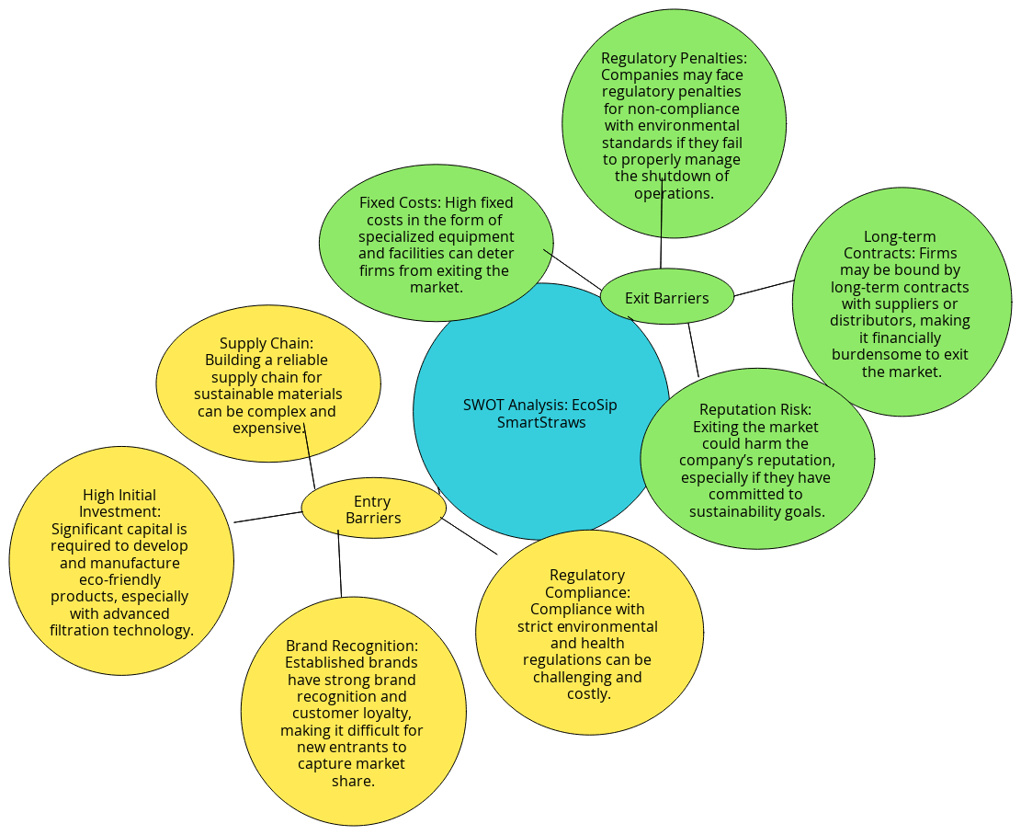
External Environment – Industry structure (entry/exit barriers)

Slide 16
External Environment – Industry structure (entry/exit barriers)
Entry Barriers:
High Initial Investment:
Challenge: Developing and manufacturing eco-friendly products, especially those incorporating advanced filtration technology, requires significant capital outlay.
Impact: This high initial cost can deter new companies from entering the market, ensuring that only well-capitalized firms can compete.
Regulatory Compliance:
Challenge: Compliance with stringent environmental and health regulations is both challenging and costly.
Impact: Companies must invest in specialized knowledge and infrastructure to meet these regulations, further increasing the entry cost and complexity.
Brand Recognition:
Challenge: Established brands have strong brand recognition and customer loyalty.
Impact: New entrants face difficulty capturing market share, as consumers are more likely to trust and stick with well-known brands.
Supply Chain:
Challenge: Building a reliable supply chain for sustainable materials is complex and expensive.
Impact: New companies need to invest time and resources to develop a sustainable supply chain, adding another layer of difficulty to market entry.

Slide 17
External Environment – Industry structure (entry/exit barriers)
Exit Barriers:
Fixed Costs:
Challenge: High fixed costs, including specialized equipment and facilities, make it financially challenging to exit the market.
Impact: Companies are discouraged from leaving the market because they have invested heavily in assets that cannot be easily liquidated or repurposed.
Regulatory Penalties:
Challenge: Firms may face penalties for non-compliance with environmental standards if they do not properly manage the shutdown of operations.
Impact: The potential financial and legal consequences make exiting the market a costly affair, forcing companies to continue operations despite unfavorable conditions.
Long-term Contracts:
Challenge: Firms are often bound by long-term contracts with suppliers or distributors.
Impact: These contracts can be financially burdensome to break, locking companies into the market and making exit strategies complicated and expensive.
Reputation Risk: Exiting the market can harm the company's reputation, especially regarding sustainability commitments.

Slide 18
External Environment – Industry structure – Competition (nature of competition, profile of competitors (background, resources, etc.), market shares, & stage of product life cycle)
Nature of Competition: The market for eco-friendly and sustainable products, including portable water purification solutions, is highly competitive. Companies are competing based on innovation, quality, sustainability, brand recognition, and pricing. The competition is intense, with several established and emerging players striving to capture market share by offering unique and effective products.
Profile of Competitors:
1) LifeStraw:
Background: LifeStraw is known for its portable water filtration products that provide safe drinking water in various situations, including emergencies and outdoor activities.
Resources: Strong focus on Research & Development, partnerships with humanitarian organizations, and effective marketing campaigns.
Market Share: Holds a significant portion of the market in portable water filtration.
Stage of Product Life Cycle: Maturity, with ongoing product diversification and market expansion.
2) Hydro Flask:
Background: Specializes in insulated water bottles and containers designed for outdoor enthusiasts and daily use.
Resources: High brand recognition, extensive retail network, and strong customer loyalty.
Market Share: Leading position in the insulated water bottle market.
Stage of Product Life Cycle: Maturity, focusing on innovation and expanding product lines.

Slide 19
External Environment – Industry structure – Competition (nature of competition, profile of competitors (background, resources, etc.), market shares, & stage of product life cycle)
3) S’well:
Background: Known for stylish and sustainable reusable bottles aimed at reducing single-use plastic.
Resources: High brand equity, extensive distribution channels, and partnerships with environmental organizations.
Market Share: Significant market share in the premium reusable bottle segment.
Stage of Product Life Cycle: Maturity, with efforts on sustainability initiatives and product development.
4) Brita:
Background: Offers water filtration products, including pitchers and bottles, designed to improve the taste and safety of drinking water.
Resources: Established brand with strong distribution and a reputation for reliability.
Market Share: Strong presence in the household water filtration market.
Stage of Product Life Cycle: Maturity, focusing on innovation and maintaining market position.
5) Grayl:
Background: Provides portable water purifiers designed for travelers and outdoor enthusiasts, known for their ease of use and effectiveness.
Resources: Innovative product design, strong online presence, and growing customer base.
Market Share: Growing presence in the portable water purification market.
Stage of Product Life Cycle: Growth, with increasing market penetration and product offerings.

Slide 20
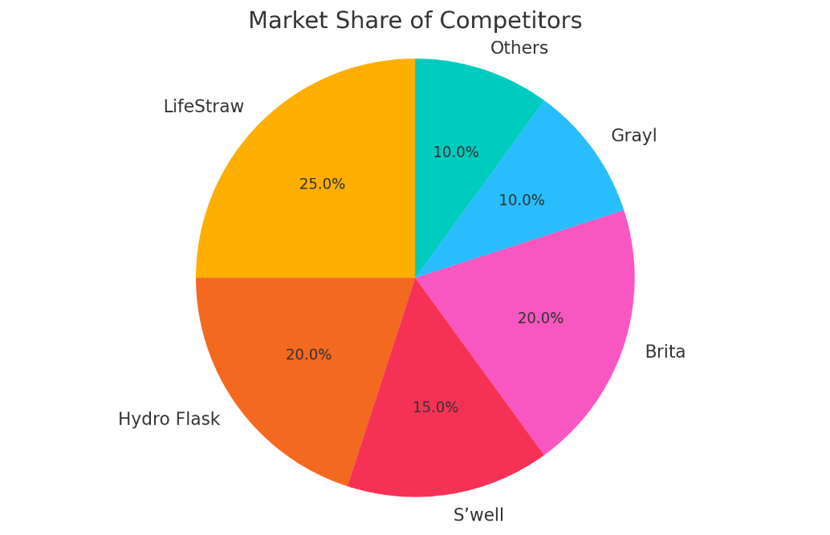
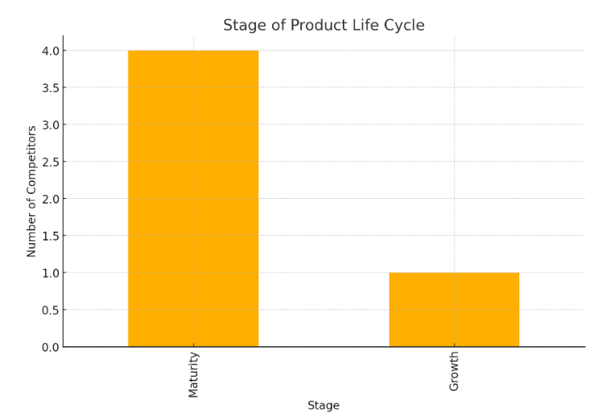
External Environment – Industry structure – Competition (nature of competition, profile of competitors (background, resources, etc.), market shares, & stage of product life cycle)
Market Share of Competitors:
The pie chart illustrates the market share distribution among competitors in the eco-friendly product segment.
LifeStraw holds the largest share at 25%, indicating a strong presence in the market.
Hydro Flask and Brita each have a significant share of 20%, suggesting robust competition.
S’well holds 15%, while Grayl and others each account for 10%, indicating a diversified competitive landscape with multiple players holding substantial market positions.
Stage of Product Life Cycle:
The bar chart shows the stage of the product life cycle for eco-friendly products.
Most competitors are in the maturity stage, with 4 competitors indicating that the market is well-established and competitive.
Only 1 competitor is in the growth stage, suggesting limited new entries and emphasizing the stability of established brands within the market.

Slide 21
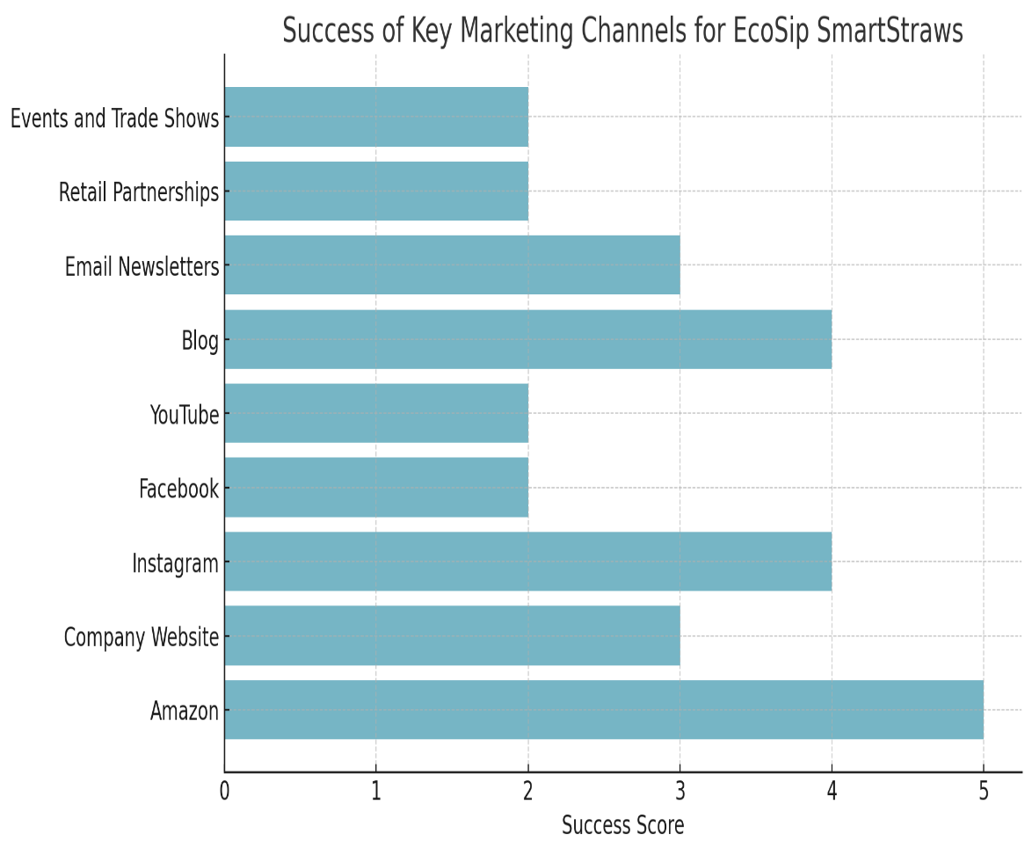
External Environment – Marketing Channels
How are the company's products/services currently marketed?
The marketing strategy for focuses on highlighting the product’s sustainability, portability, and advanced filtration technology. The most successful marketing channels for EcoSip SmartStraws have been:
E-commerce Platforms:
Amazon: High visibility and accessibility, leading to strong sales performance. Customer reviews and ratings on Amazon also enhance product credibility and influence purchasing decisions.
2) Social Media:
Instagram: Effective in building brand awareness and engagement, particularly through influencer partnerships. Visual content resonates well with the target audience, driving traffic to the website and increasing sales.
3) Content Marketing:
Blog: Establishing the brand as a thought leader in sustainability and health, attracting organic traffic and building a loyal customer base.

Slide 22
Internal Environment – Resources (Top management, Marketing, Production, Finance, research & development)
For the successful launch and growth of EcoSip SmartStraws, the following internal resources will be leveraged:
Top Management:
Leadership and Vision: The top management team will provide strategic direction and ensure alignment with the company’s mission of promoting sustainability and health.
Decision Making: Effective decision-making processes will be employed to respond swiftly to market changes and consumer needs, ensuring the product remains competitive and relevant.
2. Marketing:
Marketing Team: A dedicated marketing team will be responsible for developing and executing comprehensive marketing strategies. This includes digital marketing, social media campaigns, content creation, and influencer partnerships to build brand awareness and drive sales.
Branding and Positioning: Efforts will focus on establishing EcoSip SmartStraws as a leading eco-friendly water purification solution, highlighting its benefits and unique selling points.
3. Production:
Manufacturing Facilities: Utilizing state-of-the-art manufacturing facilities to produce high-quality, biodegradable straws with advanced filtration technology. Ensuring sustainable practices are followed throughout the production process.
Supply Chain Management: Efficient supply chain management to maintain steady production flow, manage inventory, and ensure timely delivery of products to customers.

Slide 23
Internal Environment – Resources (Top management, Marketing, Production, Finance, research & development)
4. Finance:
Budgeting and Financial Planning: The finance team will handle budgeting, financial planning, and allocation of resources to support the development, marketing, and distribution of EcoSip SmartStraws.
Funding and Investment: Securing necessary funding and investments to support Research & Development, marketing campaigns, and scaling production capabilities.
5. Research & Development:
Innovation and Improvement: The Research & Development team will focus on continuous innovation to enhance the filtration technology, improve the product’s eco-friendliness, and develop new features that meet consumer needs.
Sustainability Research: Conducting research to ensure the materials used are biodegradable and sustainable, aligning with the company’s commitment to environmental responsibility.

Slide 24
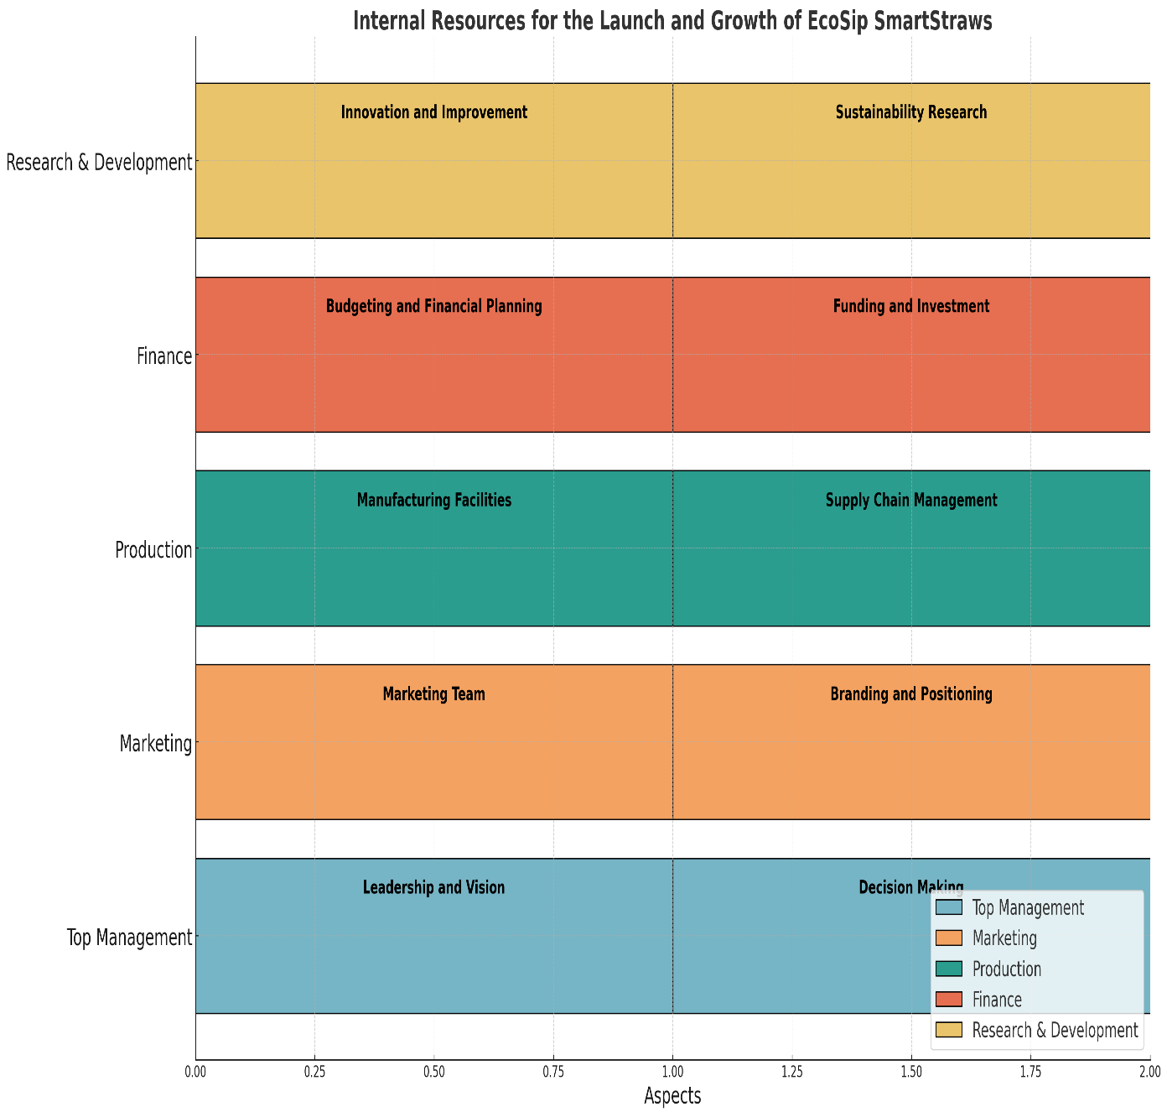
Internal Environment – Resources (Top management, Marketing, Production, Finance, research & development)
Analysis of Internal Resources for EcoSip SmartStraws:
Key Points:
Top Management: Focuses on leadership, vision, and effective decision-making.
Marketing: Dedicated team and strong branding efforts.
Production: State-of-the-art facilities and efficient supply chain management.
Finance: Emphasis on budgeting, financial planning, and securing investments.
Research & Development: Continuous innovation and commitment to sustainability.

Slide 25
Internal Environment – Brand diagnosis (current brand positioning, current pricing strategy, current distribution strategy, & current promotions strategy)
Current Brand Positioning:
EcoSip SmartStraws are positioned as a premium, eco-friendly, and innovative solution for portable water purification.
The brand focuses on sustainability, health, and convenience, appealing to eco-conscious consumers, outdoor enthusiasts, and health-focused individuals.
The product is marketed as a high-quality, biodegradable straw equipped with advanced filtration technology, ensuring safe drinking water on-the-go.
Current Pricing Strategy: EcoSip SmartStraws are priced at a premium to reflect their advanced filtration technology, biodegradability, and high-quality materials. The pricing strategy is designed to emphasize the product's value proposition, targeting consumers who are willing to pay more for sustainable and health-oriented products. Additionally, the pricing strategy includes:
Bundle Offers: Discounts on bulk purchases to encourage higher sales volumes.
Seasonal Promotions: Special pricing during peak seasons such as summer, when outdoor activities increase.

Slide 26
Internal Environment – Brand diagnosis (current brand positioning, current pricing strategy, current distribution strategy, & current promotions strategy)
Current Distribution Strategy: EcoSip SmartStraws are distributed through multiple channels to maximize reach and accessibility. The current distribution strategy includes:
E-commerce Platforms: Available on major online marketplaces such as Amazon and the company’s own website, providing global access to consumers.
Retail Partnerships: Collaborations with eco-friendly and outdoor retail stores, offering physical locations for consumers to purchase the product.
Direct-to-Consumer: Leveraging the company’s website for direct sales, providing detailed product information and customer support.
Current Promotions Strategy: The promotional strategy for EcoSip SmartStraws focuses on building brand awareness, educating consumers about the benefits of the product, and driving sales. The current promotions strategy includes:
Social Media Marketing: Utilizing platforms like Instagram, Facebook, and YouTube to share engaging content, including lifestyle images, videos, and influencer collaborations.
Content Marketing: Publishing informative articles and blog posts on the company’s website about sustainability, health benefits of clean water, and tips for outdoor activities.
Email Marketing: Sending newsletters to subscribers with updates on new products, special offers, and sustainability tips.

Slide 27
Internal Environment – Problem definition & Critical Factors
Factors within the organization that will help the proposal:
Strong Leadership and Vision:
The top management’s commitment to sustainability and innovation will drive the successful development and marketing of EcoSip SmartStraws. Their vision aligns with the product’s goals of providing eco-friendly and health-conscious solutions.
2. Dedicated Marketing Team:
A skilled marketing team with experience in digital marketing, social media, and influencer partnerships will effectively promote the product and reach the target audience. Their expertise will ensure strong brand positioning and engagement.
3. Advanced Research & Development:
The Research & Development team’s focus on continuous innovation and improvement will enhance the product’s filtration technology and sustainability. Their work ensures that EcoSip SmartStraws remain competitive and meet consumer needs.
4. Robust Financial Planning:
Efficient financial management will secure the necessary funding for product development, marketing campaigns, and scaling production capabilities. This financial stability is crucial for long-term success.
5. Efficient Production and Supply Chain Management:
High-quality manufacturing facilities and effective supply chain management will ensure consistent product quality and timely delivery. This reliability is essential for maintaining customer trust and satisfaction.

Slide 28
Internal Environment – Problem definition & Critical Factors
Factors within the organization that hinders the proposal:
1. Limited Market Penetration:
If the brand lacks sufficient market penetration and awareness, it could hinder the initial adoption of EcoSip SmartStraws. Overcoming this requires effective marketing strategies and strong distribution channels.
2. High Production Costs:
The costs associated with producing high-quality, biodegradable materials and advanced filtration technology could impact pricing and profit margins. Efficient cost management and potential economies of scale are necessary to mitigate this risk.
3. Regulatory Challenges:
Compliance with varying environmental and health regulations across different markets can be complex and costly. Navigating these regulatory landscapes requires dedicated resources and expertise.
4. Competitive Market:
The presence of established competitors with strong brand recognition and customer loyalty presents a challenge. Differentiating EcoSip SmartStraws through unique features and effective branding is essential to capture market share.
5. Resource Allocation:
Balancing the allocation of resources between Resource & Development, marketing, production, and other critical areas is crucial. Misallocation or underfunding in any area could impede overall progress and success.

Slide 29
Segmentation, Targeting & Positioning

Slide 30
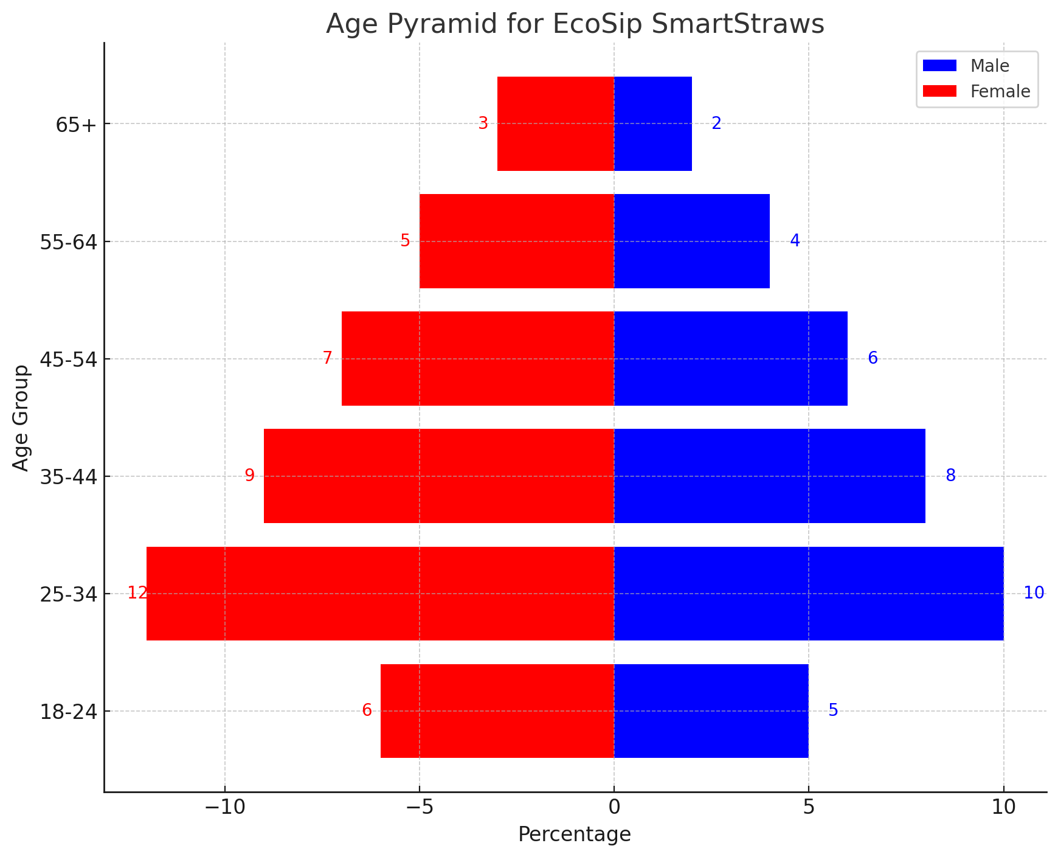
Market Analysis & Segmentation – Who is/are the market?
Overall observations:
Gender Distribution: Across all age groups, females consistently show a slightly higher percentage of interest in EcoSip SmartStraws compared to males. This suggests that the product's appeal aligns with the preferences or needs of female consumers.
Age Distribution: The product is most popular among individuals aged 25-34, followed by those aged 35-44. There is a clear trend of decreasing interest as age increases, which is typical for many consumer products that appeal more to younger demographics.
Target Demographic: The primary target demographic for EcoSip SmartStraws appears to be young to middle-aged adults, particularly those in the 25-34 age range. Marketing efforts could be focused more on this group to maximize reach and sales.

Slide 31
Market Analysis & Segmentation –
What does the market buy?
The market buys eco-friendly and sustainable water purification solutions. Specifically, EcoSip SmartStraws, which are biodegradable straws equipped with advanced filtration technology, allowing users to drink directly from any water source while ensuring the water is safe and clean. Consumers are looking for products that are convenient, portable, and align with their environmental values.
When does the market buy?
The market tends to buy EcoSip SmartStraws during key periods such as:
Summer and Outdoor Seasons: Increased outdoor activities, camping, hiking, and travel drive the demand for portable water purification solutions.
Holiday Seasons: Gifting opportunities during holidays like Christmas, Earth Day, and other eco-centric celebrations.
Special Promotions: During sales events, product launches, and promotional campaigns which offer discounts or bundled deals.
Where does the market buy?
Consumers purchase EcoSip SmartStraws through various channels including:
E-commerce Platforms: Major online marketplaces like Amazon and the company’s own website.
Retail Stores: Eco-friendly and outdoor retail stores that stock sustainable products.
Social Media Shops: Direct purchase options through social media platforms such as Instagram and Facebook.

Slide 32
Market Analysis & Segmentation –
Why does the market buy?
Environmental Concerns: Consumers are motivated by the desire to reduce plastic waste and contribute to environmental sustainability. EcoSip SmartStraws offer a biodegradable alternative to single-use plastic straws.
Health and Safety: The advanced filtration technology ensures safe drinking water, protecting consumers from harmful bacteria, viruses, and contaminants.
Convenience and Portability: The ability to purify water on-the-go makes it a practical choice for outdoor enthusiasts, travelers, and anyone needing reliable access to clean water.

Slide 33
Market Targeting – Who is/are the target audience(s)?
Primary Target Audience:
Eco-Conscious Consumers:
Demographics: Age 18-45, both male and female, typically middle to high income, higher education levels.
Psychographics: Highly concerned about environmental issues and sustainability. They actively seek out products that reduce their ecological footprint and support green initiatives.
Behavior: Likely to participate in recycling, composting, and purchasing eco-friendly products. They follow eco-friendly brands and influencers on social media.
2. Outdoor Enthusiasts and Adventurers:
Demographics: Age 18-54, both male and female, typically middle to high income.
Psychographics: Passionate about outdoor activities such as hiking, camping, backpacking, and travel. They value practical, portable, and reliable products for their adventures.
Behavior: Frequently purchase gear and equipment for outdoor activities, follow outdoor adventure blogs, and are members of outdoor recreation groups.
3. Health-Conscious Individuals:
Demographics: Age 25-55, both male and female, middle to high income, typically higher education levels.
Psychographics: Prioritize health and wellness in their lifestyle choices. They are cautious about the quality of food and water they consume and are willing to invest in products that enhance their well-being.
Behavior: Regularly buy organic and health-oriented products, follow health and wellness influencers, and participate in fitness and wellness activities.

Slide 34
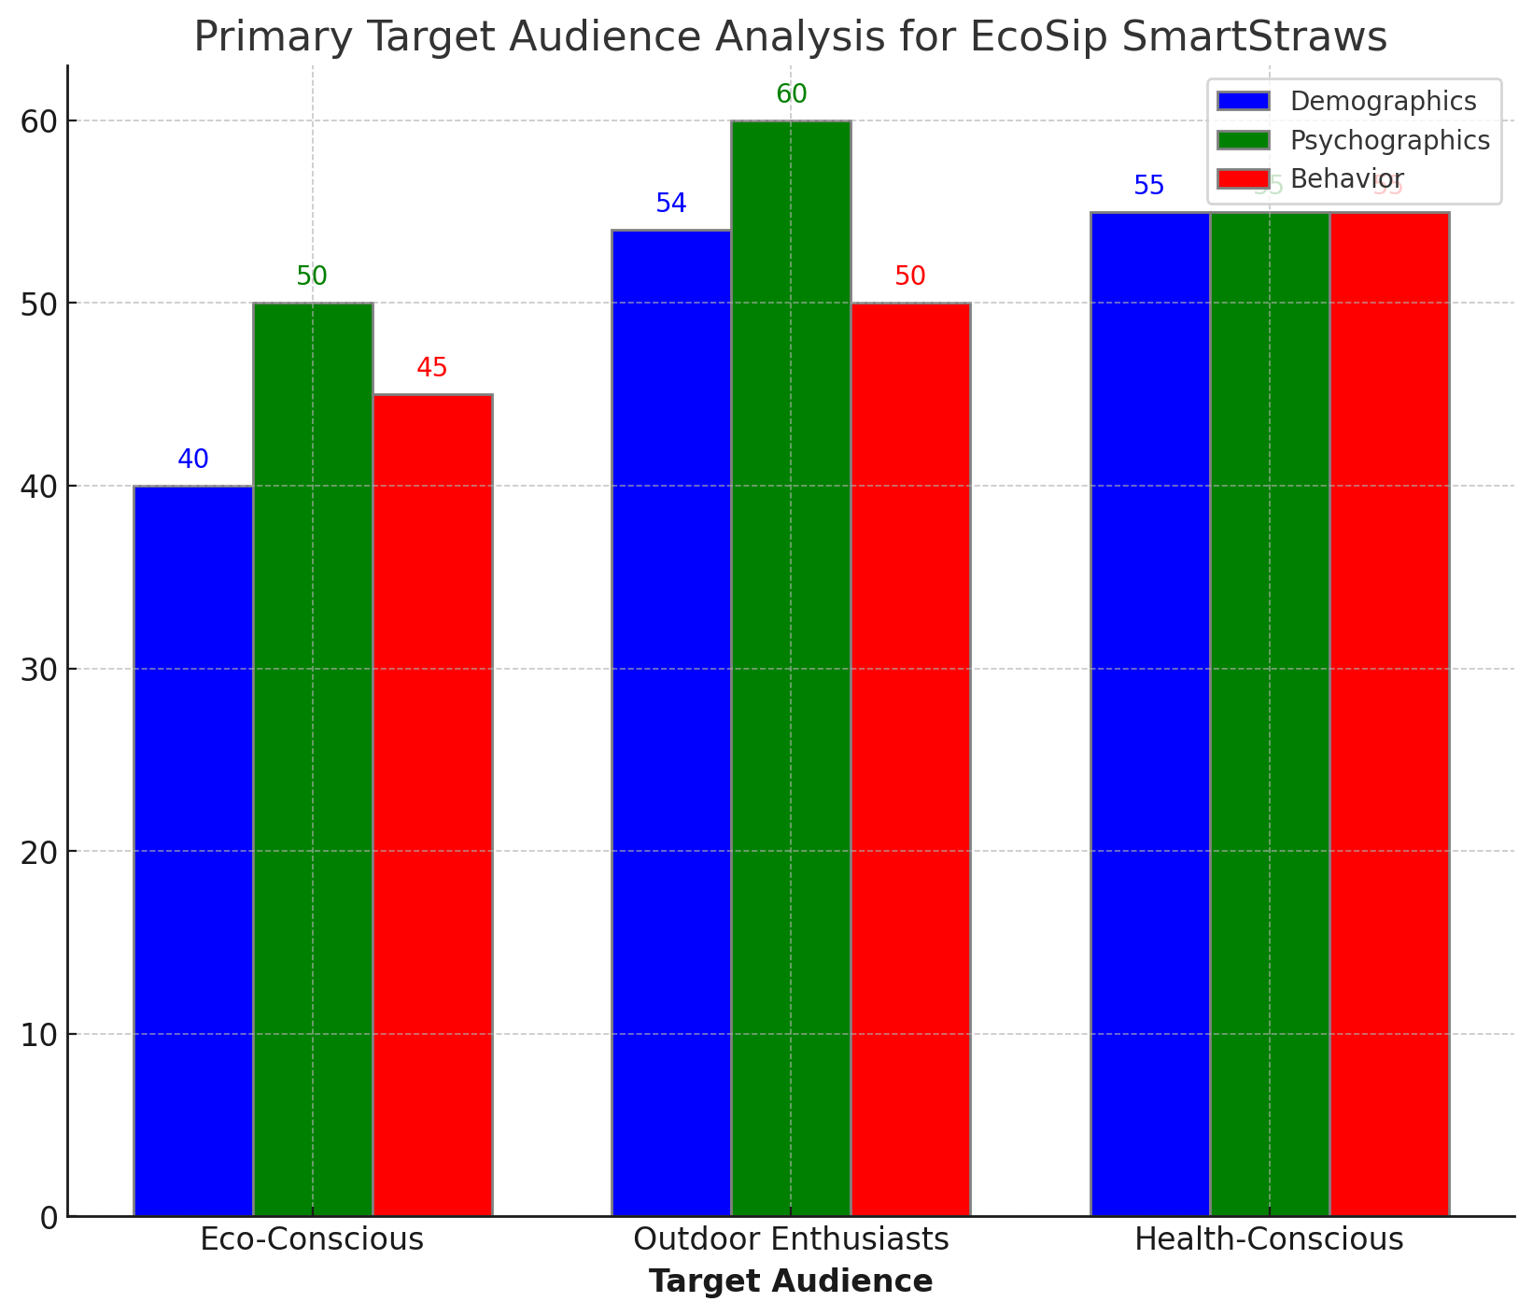
Market Targeting – Who is/are the target audience(s)?
Bar Chart Key Insights:
Outdoor Enthusiasts and Adventurers score the highest in psychographics (60), indicating a strong interest in outdoor activities.
Health-Conscious Individuals show balanced scores across all three dimensions, suggesting consistent interest in health and wellness.
Eco-Conscious Consumers have a notable engagement in psychographics but slightly lower in demographics and behavior compared to the other groups.

Slide 35
Market Targeting – Who is/are the target audience(s)?
Secondary Target Audience:
Families with Young Children:
Demographics: Age 30-45, both male and female, typically middle to high income.
Psychographics: Focused on providing safe and healthy environments for their children. They are concerned about the quality of water their children consume, especially when traveling or engaging in outdoor activities.
Behavior: Purchase family-friendly and health-focused products, follow parenting blogs and forums, and participate in family-oriented activities.
2. Travelers:
Demographics: Age 18-55, both male and female, middle to high income.
Psychographics: Enjoy exploring new places and cultures. They seek convenient and reliable solutions for clean water while traveling, especially in regions where water quality is a concern.
Behavior: Frequently purchase travel accessories, follow travel blogs and influencers, and participate in travel forums.
3. Environmentally Responsible Corporates:
Demographics: Corporate organizations with sustainability initiatives, typically larger companies with corporate social responsibility (CSR) programs.
Psychographics: Committed to reducing their environmental impact and promoting sustainability within their organization and to their customers.
Behavior: Purchase eco-friendly products in bulk for corporate use, support green initiatives, and participate in sustainability conferences and expos.

Slide 36
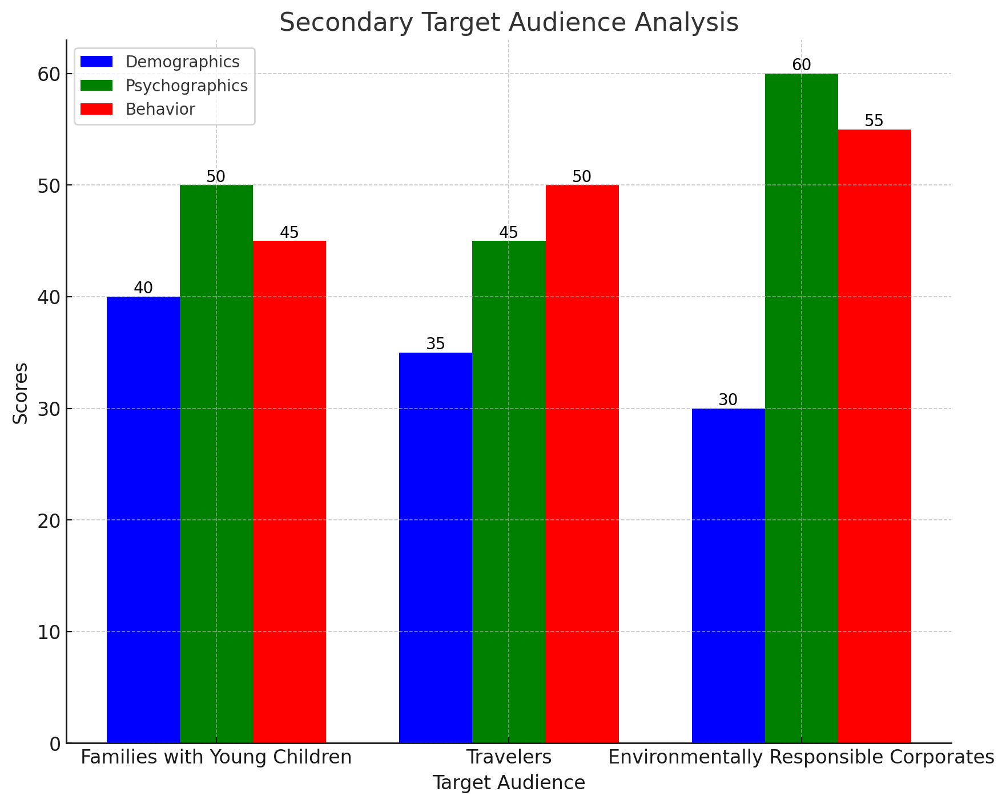
Market Targeting – Who is/are the target audience(s)?

Slide 37
Market Targeting – Who is/are the target audience(s)?
Bar Chart Key Insights:
1. Families with Young Children
Demographics: Score 40 - Moderate demographic importance.
Psychographics: Score 50 - High concern for health and safety.
Behavior: Score 45 - Actively purchase family-friendly products and engage in parenting activities.
2. Travelers
Demographics: Score 35 - Moderate demographic importance.
Psychographics: Score 45 - High concern for water quality and convenience.
Behavior: Score 50 - Actively purchase travel accessories and follow travel content.
3. Environmentally Responsible Corporates
Demographics: Score 30 - Less focus on individual demographics.
Psychographics: Score 60 - Highest commitment to sustainability.
Behavior: Score 55 - Actively support and engage in green initiatives.
4. Summary
Families with Young Children: High health/safety concerns, active in family-oriented activities.
Travelers: High water quality concerns, active in travel-related activities.
Corporates: Strongest sustainability commitment, active in green initiatives.

Slide 38
Market Positioning – Proposed brand positioning
Proposed Brand Positioning for EcoSip SmartStraws:
Positioning Statement: EcoSip SmartStraws are positioned as the ultimate eco-friendly, portable water purification solution designed for health-conscious, environmentally aware individuals who seek convenience and reliability. The brand promises high-quality, biodegradable straws with advanced filtration technology that ensures safe drinking water on-the-go, aligning with a commitment to sustainability and health.
Key Positioning Elements:
Eco-Friendly:
EcoSip SmartStraws are made from biodegradable materials, catering to consumers who prioritize reducing their environmental impact. The brand's commitment to sustainability differentiates it from traditional single-use plastic products.
Health and Safety:
The advanced filtration technology guarantees safe drinking water by eliminating harmful bacteria, viruses, and contaminants. This assurance appeals to health-conscious consumers, outdoor enthusiasts, and families.
Convenience and Portability:
Designed for on-the-go use, EcoSip SmartStraws provide a practical solution for travelers, hikers, and anyone needing reliable access to clean water. The product's portability enhances its appeal to a broad audience.
Premium Quality:
The brand emphasizes high-quality materials and effective filtration technology, positioning EcoSip SmartStraws as a premium product worth the investment.

Slide 39
Market Positioning – Proposed brand positioning
Expansion and Enhancement of Existing Brand:
Aligning with Brand Values: EcoSip SmartStraws reinforce the company’s commitment to sustainability and health. By adding a biodegradable water purification product to the brand portfolio, the company strengthens its position as a leader in eco-friendly solutions.
Broadening the Product Range: Introducing EcoSip SmartStraws expands the company's product range, attracting new customer segments such as outdoor enthusiasts and health-focused individuals. This diversification helps the brand capture a larger market share.
Enhanced Brand Image: The innovation and eco-friendliness of EcoSip SmartStraws enhance the overall brand image, portraying the company as forward-thinking and dedicated to addressing environmental and health concerns.
Impact on Brand Positioning:
Competitive Advantage: By positioning EcoSip SmartStraws as a superior alternative to conventional water purification methods, the brand gains a competitive edge in the market. This differentiation supports long-term brand loyalty and growth.
Consumer Perception: The eco-friendly and health-focused positioning of EcoSip SmartStraws positively influences consumer perception, associating the brand with quality, innovation, and sustainability. This perception drives consumer preference and advocacy.
Market Penetration: The strong positioning of EcoSip SmartStraws facilitates deeper market penetration, enabling the brand to reach new demographics and geographic locations. This expansion supports the brand's growth objectives and market presence.

Slide 40
Market Positioning – Communication objectives
Goals and Objectives for EcoSip SmartStraws Communication Strategy:
Increase Brand Awareness:
Objective: Raise awareness of EcoSip SmartStraws among target audiences, including eco-conscious consumers, outdoor enthusiasts, health-conscious individuals, families, and travelers.
Strategy: Utilize digital marketing channels such as social media, content marketing, and influencer partnerships to reach a broad audience. Participate in industry events and trade shows to showcase the product.
Educate Consumers:
Objective: Inform consumers about the benefits of EcoSip SmartStraws, including its eco-friendly materials, advanced filtration technology, and health advantages.
Strategy: Develop and share educational content through blog posts, videos, infographics, and social media posts. Collaborate with health and environmental influencers to spread the message.
3. Build Brand Loyalty and Advocacy:
Objective: Foster a loyal customer base that advocates for EcoSip SmartStraws and the brand's sustainability mission.
Strategy: Engage with customers through social media interactions, personalized email campaigns, and loyalty programs. Encourage user-generated content and reviews to build a community around the brand.

Slide 41
Market Positioning – Communication objectives
Implementation Plan:
Digital Marketing:
Social Media: Regular posts on platforms like Instagram, Facebook, and Twitter. Use targeted ads to reach specific demographics.
Content Marketing: Publish blog articles, videos, and infographics that educate and inform the audience about EcoSip SmartStraws.
Influencer Partnerships: Collaborate with influencers in the sustainability, health, and outdoor niches to reach a wider audience.
2. Email Marketing:
Send newsletters and promotional emails to subscribers, providing updates, special offers, and educational content.
3. Advertising:
Run targeted ads on Google, Facebook, and other platforms to drive traffic to the company’s website and e-commerce listings.

Slide 42
Operations Plan

Slide 43
Operations Plans – Describe your plan for cost, quality, variety and responsiveness of the new line
1. Distribution Channels:
E-commerce Platforms:
Amazon: Utilize Amazon’s extensive reach and reliable logistics to ensure fast delivery.
Company Website: Direct sales through the official website to offer detailed product information and exclusive deals.
Retail Partnerships:
Eco-Friendly Retailers: Partner with stores specializing in sustainable products to align with the brand’s values.
Outdoor and Adventure Stores: Stock EcoSip SmartStraws in stores frequented by outdoor enthusiasts and travelers.
Direct-to-Consumer:
Social Media Shops: Sell directly through platforms like Instagram and Facebook for easy access to the target audience.

Slide 44
Operations Plans – Describe your plan for cost, quality, variety and responsiveness of the new line
2. Operational Flow:
Cost Efficiency:
Bulk Purchasing: Source raw materials in bulk to reduce costs and negotiate better rates.
Automation: Implement automated production processes to minimize labor costs and increase efficiency.
Lean Manufacturing: Adopt lean manufacturing principles to reduce waste and optimize resource use.
Quality:
Strict Quality Control: Implement rigorous quality control measures at every stage of production to ensure high standards.
Supplier Audits: Regularly audit suppliers to ensure they meet the company’s quality and sustainability criteria.
Customer Feedback: Collect and analyze customer feedback to continuously improve product quality.
Variety:
Product Customization: Offer customizable options such as different colors and sizes to cater to diverse customer preferences.
Seasonal Collections: Introduce limited-edition seasonal collections to keep the product line fresh and appealing.
Expansion: Plan for future expansions of the product line to include related eco-friendly water purification solutions.
Responsiveness:
Agile Manufacturing: Adopt agile manufacturing techniques to quickly adapt to market demands and trends.
Flexible Supply Chain: Develop a flexible supply chain that can respond to fluctuations in demand and supply.
Inventory Management: Use advanced inventory management systems to ensure optimal stock levels and avoid shortages or overstocking.

Slide 45
Operations Plans – Describe your plan for cost, quality, variety and responsiveness of the new line
Implementation Steps:
1. Initial Setup:
Supplier Agreements: Secure agreements with suppliers for sustainable raw materials.
Manufacturing Setup: Establish manufacturing processes and set up production lines.
Quality Control Systems: Develop and implement quality control protocols.
2. Launch Phase:
Marketing Campaigns: Roll out comprehensive marketing campaigns across e-commerce platforms, social media, and retail partners.
Distribution Network: Establish a distribution network to ensure efficient delivery and availability of products.
3. Continuous Improvement:
Monitor and Adjust: Regularly monitor operational performance and make necessary adjustments to improve efficiency and responsiveness.
Customer Engagement: Engage with customers through feedback and surveys to understand their needs and preferences.
Innovate: Continuously innovate and enhance the product line based on market trends and consumer insights.

Slide 46
Financial Plan

Slide 47
Financial Plan – Estimate of costs and revenue for the new line
EcoSip SmartStraws Financial Plan:
Exchange Rate: 1 USD = 3.67 AED
Terms of the Offer:
Retail Price: The retail price for EcoSip SmartStraws is set at 91.62 AED per unit. This price reflects the premium quality, advanced filtration technology, and eco-friendly materials used in the product.
Bulk Purchase Discounts: Discounts are offered for bulk purchases to encourage higher sales volumes. For example, a 10% discount for orders of 10-19 units, a 15% discount for orders of 20-49 units, and a 20% discount for orders of 50 or more units.
Subscription Model: Customers can subscribe to receive new EcoSip SmartStraws every three months at a discounted rate of 82.60 AED per unit, promoting repeat purchases and customer loyalty.

Slide 48
Financial Plan – Estimate of costs and revenue for the new line
Projected Costs:
Production Costs:
Materials: Biodegradable materials, advanced filtration components, and packaging.
Estimated Cost: 22.02 AED per unit
Manufacturing: Labor, machinery maintenance, and production overhead.
Estimated Cost: 14.68 AED per unit
Operational Costs:
Marketing and Advertising: Digital marketing campaigns, influencer partnerships, content creation, and event participation.
Estimated Cost: 7.34 AED per unit
Distribution and Logistics: Shipping, warehousing, and handling fees.
Estimated Cost: 11.01 AED per unit
Research and Development: Continuous improvement of filtration technology and product innovation.
Estimated Cost: 5.51 AED per unit
Fixed Costs:
Salaries and Wages: Staff salaries for management, marketing, production, and Research & Development teams.
Estimated Annual Cost: 1,101,000 AED
Rent and Utilities: Costs for office and production facilities.
Estimated Annual Cost: 367,000 AED
Miscellaneous Overhead: Administrative expenses, insurance, and other overhead costs.
Estimated Annual Cost: 184,000 AED

Slide 49
Financial Plan – Estimate of costs and revenue for the new line
Total Cost per Unit: 60.56 AED
Projected Revenue:
Monthly Sales Volume: 5,000 units
Monthly Revenue: 5,000 units x 91.62 AED per unit = 458,100 AED
Annual Revenue: 458,100 AED x 12 months = 5,497,200 AED
Projected Profit:
Monthly Profit: (Retail Price - Total Cost per Unit) x Monthly Sales Volume
(91.62 AED - 60.56 AED) x 5,000 units = 155,300 AED
Annual Profit: 155,300 AED x 12 months = 1,863,600 AED
Break-Even Analysis:
Break-Even Point: Fixed Costs / (Retail Price - Variable Cost per Unit)
1,652,000 AED / (91.62 AED - 60.56 AED) = 52,941 units (approximately 53,000 units)
Financial Summary:
Total Annual Revenue: 5,497,200 AED
Total Annual Cost: (60.56 AED x 60,000 units) + 1,652,000 AED = 5,437,600 AED
Total Annual Profit: 5,497,200 AED - 5,437,600 AED = 59,600 AED

Slide 50
Integration & Evaluation

Slide 51
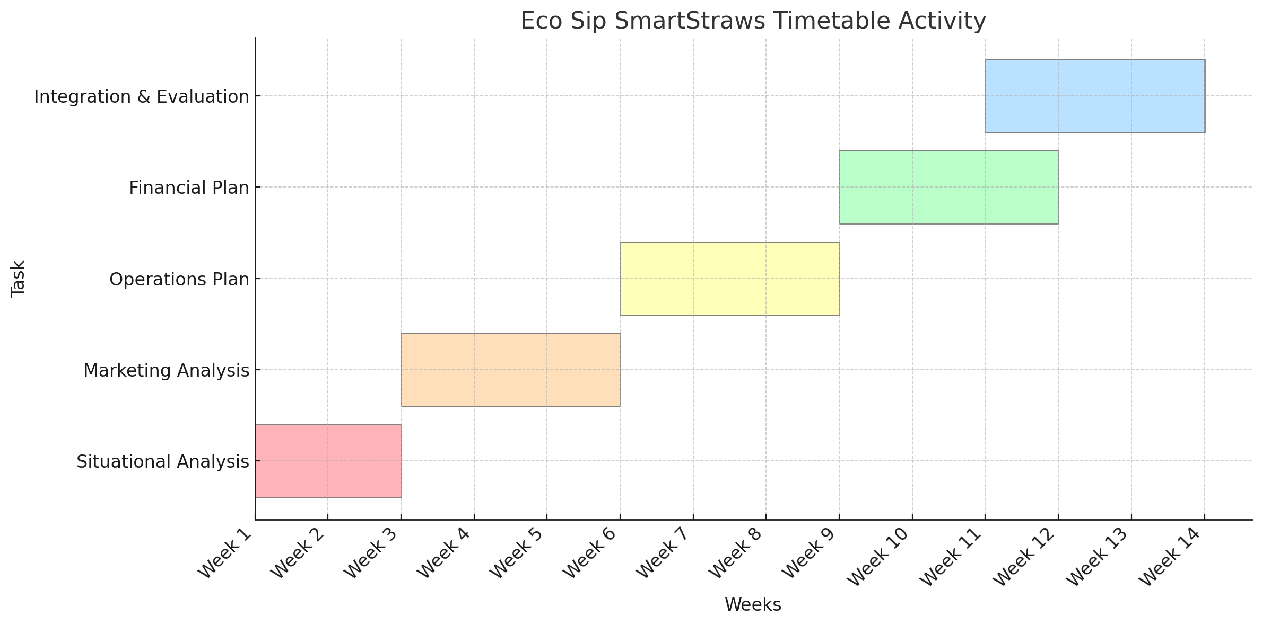
Timetable of Activities

Slide 52
Evaluation
Evaluation Plan for EcoSip SmartStraws:
How will you evaluate success? Success will be evaluated by measuring the achievement of specific objectives related to sales, market penetration, customer satisfaction, and brand awareness. Key performance indicators will be tracked to ensure that the product meets its targets and contributes to the overall growth of the company.
What are the criteria to be used for evaluation?
Sales Performance:
Monthly and annual sales volume and revenue targets.
Comparison of actual sales against projected sales.
Market Penetration:
Number of retail partners and distribution channels secured.
Geographical reach and expansion into new markets.
Customer Satisfaction:
Customer feedback and ratings on e-commerce platforms.
Customer retention rates and repeat purchase behavior.
Brand Awareness:
Social media engagement metrics.
Website traffic and conversion rates.
Media coverage and influencer endorsements.

Slide 53
Evaluation
What kind of data will you collect?
Sales Data:
Total units sold per month.
Revenue generated from sales.
Sales by channel.
Customer Data:
Customer reviews and ratings.
Feedback from customer service interactions.
Survey responses regarding product satisfaction and improvements.
Marketing Data:
Social media metrics.
Website analytics.
Advertising performance.
Operational Data:
Production costs and efficiency metrics.
Inventory levels and turnover rates.
Delivery times and order fulfillment accuracy.

Slide 54
Evaluation
When and how will the data be collected?
Monthly Reports:
Sales and revenue data will be collected and analyzed monthly.
Customer feedback and reviews will be monitored continuously and summarized in monthly reports.
Marketing performance metrics will be reviewed monthly to adjust strategies as needed.
Quarterly Reviews:
Comprehensive reviews of sales performance, market penetration, and operational efficiency will be conducted quarterly.
Customer satisfaction surveys will be distributed quarterly to gather detailed feedback.
Annual Evaluation:
A thorough evaluation of the overall performance of EcoSip SmartStraws will be conducted annually.
Annual reports will summarize key findings, successes, and areas for improvement.
Strategic planning sessions will be held to set objectives for the next year based on the annual evaluation.

Slide 55
Evaluation
Data Collection Methods:
Sales and Customer Data:
Utilize Customer Relationship Management systems and e-commerce analytics tools to gather sales and customer data.
Conduct online surveys and use feedback forms to collect customer feedback.
Marketing Data:
Use social media analytics tools to track engagement metrics.
Implement website analytics tools to monitor traffic and conversions.
Monitor advertising performance using platforms’ built-in analytics.
Operational Data:
Track production and inventory data using Enterprise Resource Planning systems.
Collect delivery and order fulfillment data from logistics and supply chain management systems.

Slide 56
Evaluation
High Production Costs
Issue: Production costs may exceed initial estimates, affecting profitability.
Solution:
Cost Optimization: Review and optimize the production process to identify cost-saving opportunities. This may include negotiating better rates with suppliers or investing in more efficient manufacturing technologies.
Scale Economies: Increase production volume to achieve economies of scale, reducing the cost per unit.
Alternative Materials: Research and consider using alternative materials that maintain quality but are more cost-effective.
Strong Competition
Issue: Competitors with established brands and market presence may limit EcoSip SmartStraws' market penetration.
Solution:
Differentiation: Clearly communicate the Unique Selling Propositions of EcoSip SmartStraws, such as biodegradability and advanced filtration technology.
Partnerships: Form strategic partnerships with environmental organizations, outdoor activity groups, and health influencers to boost credibility and reach.
Continuous Innovation: Invest in Research & Development to continuously improve the product and introduce new features that meet evolving consumer needs.

